Slide 1
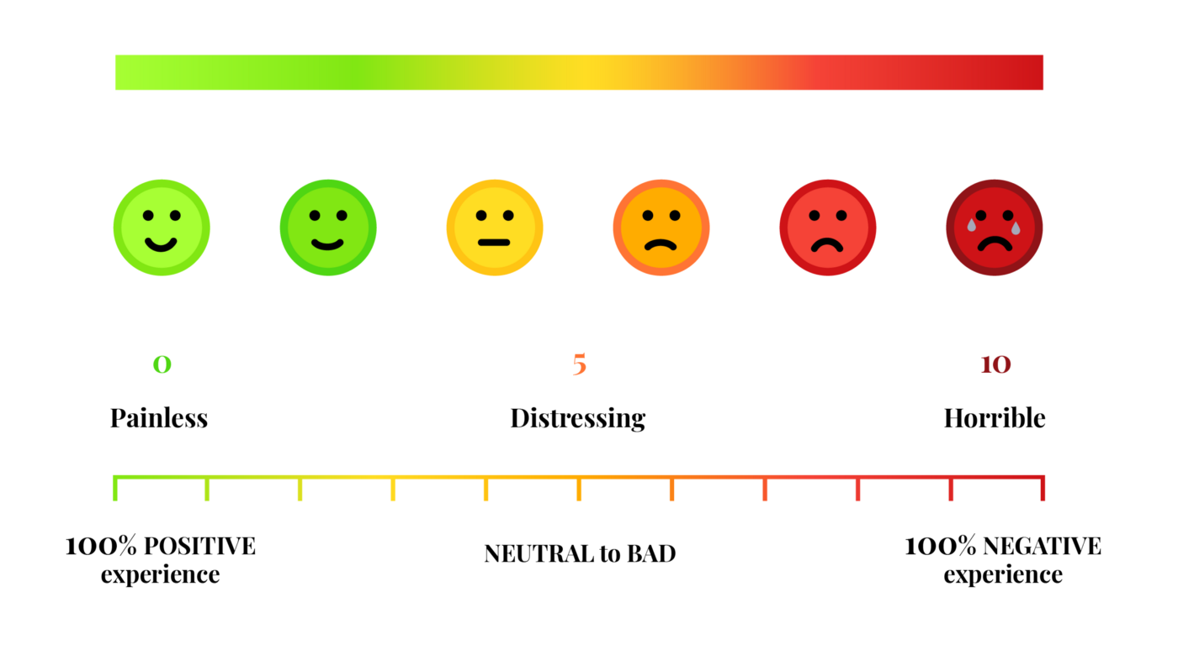

PAIN POINTS
Pain points are specific problems faced by current or prospective customers in the marketplace.
Pain points include any problems the customer may experience along their journey.

Slide 2
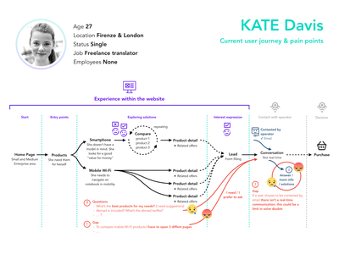
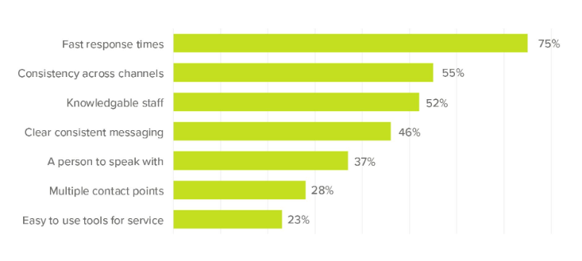
EXAMPLES OF PAIN POINTS

